Slide 1
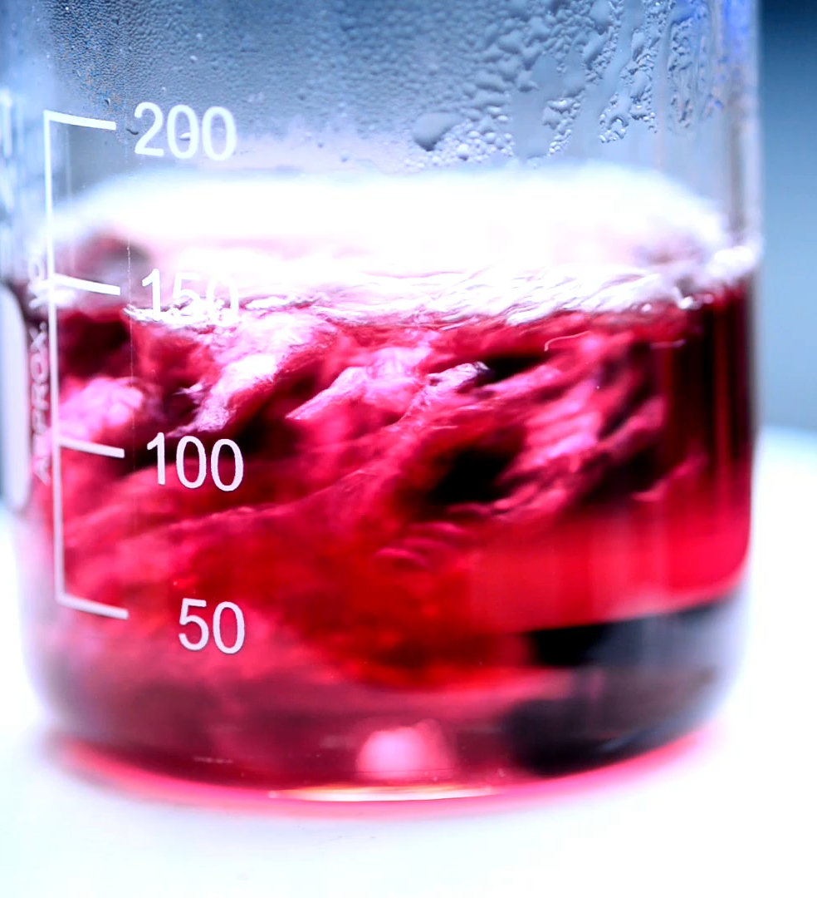
Liquid-Liquid Extraction
04/21/2026
Anna Cai, Aaron Casas, Adil Feratovic, Hussein Rezk

Slide 2
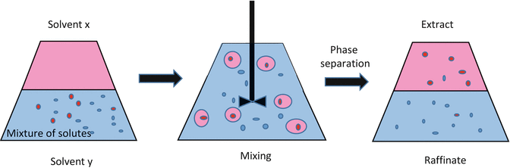
Introduction & Background
Liquid-Liquid Extraction:
Process where a solute transfers between two immiscible fluids to achieve separation
Driven by differences in equilibrium distribution and solubility
Useful when distillation is inefficient
In this experiment:
Acetic Acid (solute)
White oil (raffinate phase)
Water (solvent/extract phase)

Slide 3
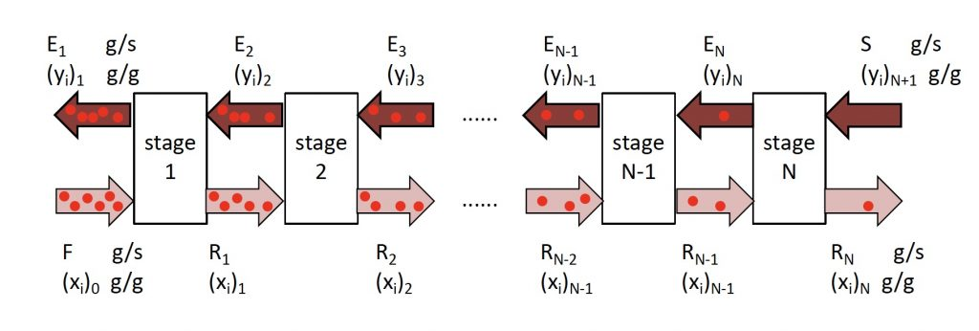
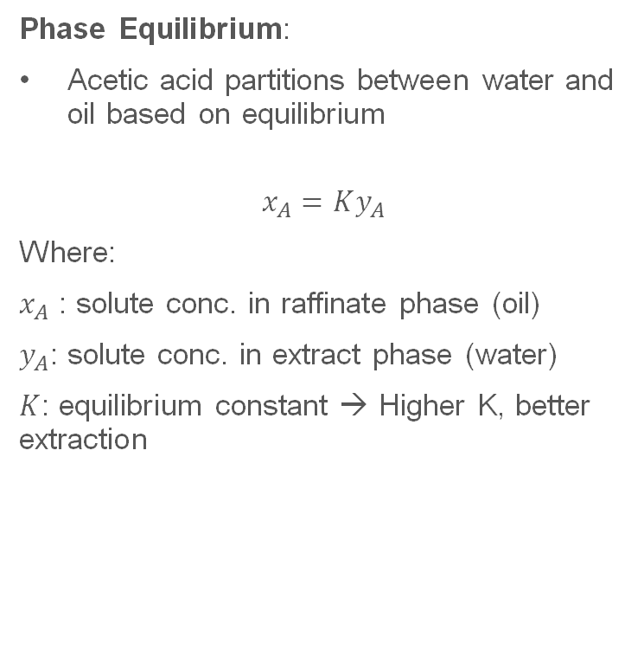
Principles Behind the Experiment
Phase Equilibrium:
Acetic acid partitions between water and oil based on equilibrium
$$x_{A}=Ky_{A}$$
Where:
$x_{A}$ : solute conc. in raffinate phase (oil)
$y_{A}$: solute conc. in extract phase (water)
$K$: equilibrium constant → Higher K, better extraction
Mass Transfer:
Concentration gradients during mixing in the agitator
Countercurrent Flow:
Phases flow in opposite directions
Maximizes driving force across stages

Slide 4
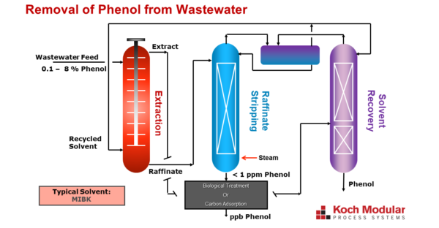
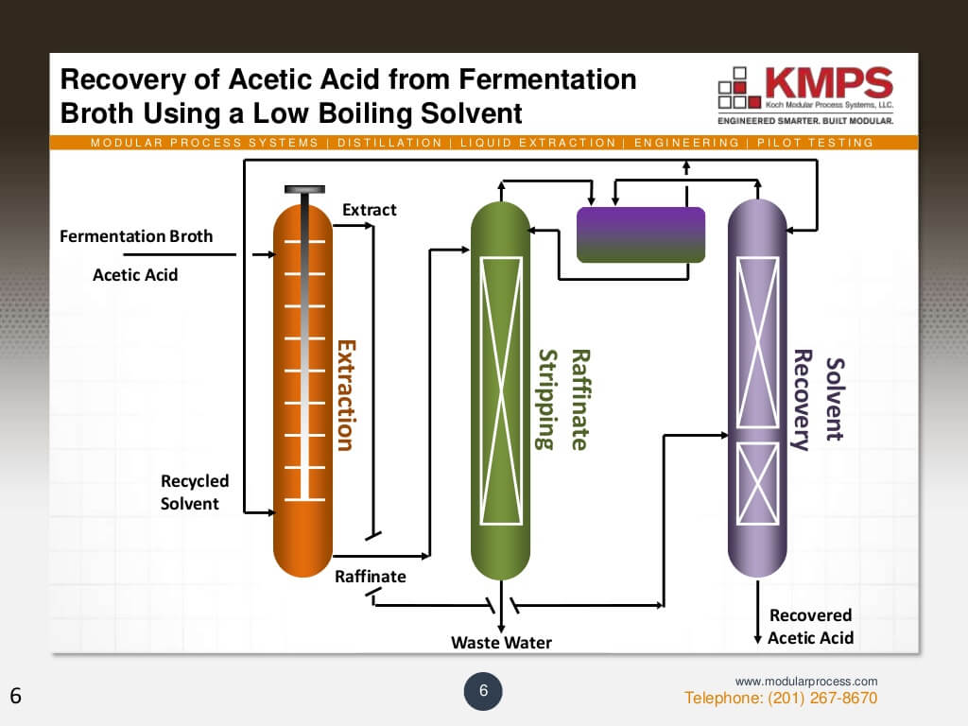
Industrial Applications
Petroleum Industry:
Used to remove impurities from fuels
Environmental Industry:
Used to remove pollutants from wastewater
Pharmaceutical Industry:
Used to purify active ingredients

Slide 5
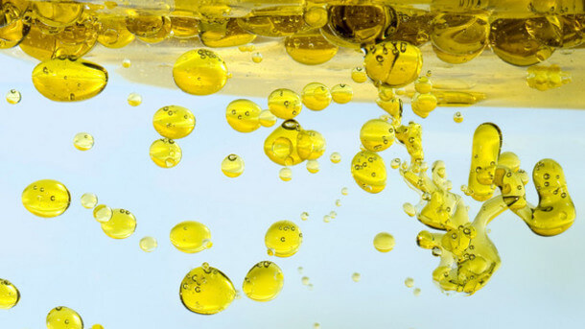
Experimental Objectives
Operate a 3-stage extraction unit
Extract acetic acid from oil using water
Assess how agitator speed affects efficiency

Slide 6
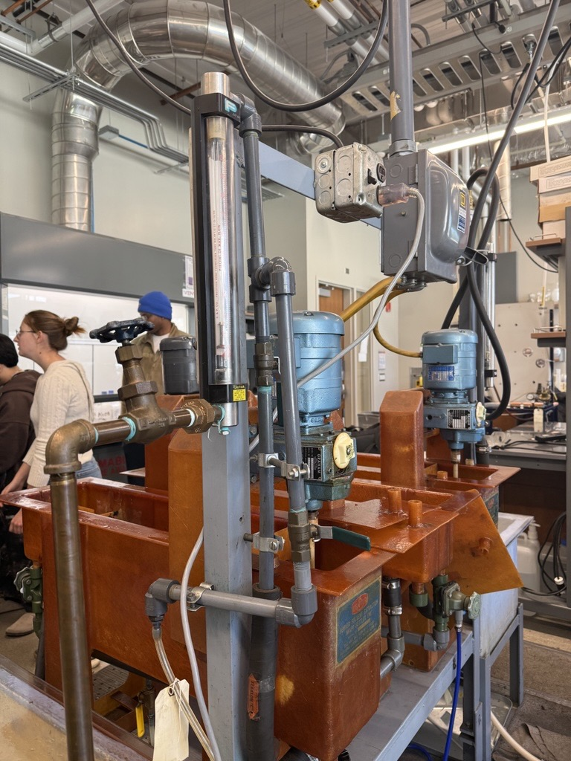
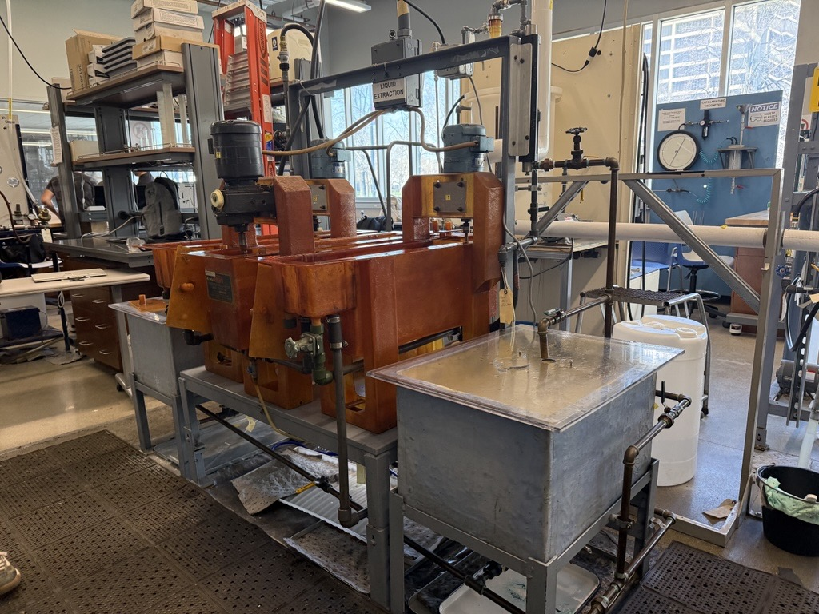
Apparatus

Slide 7
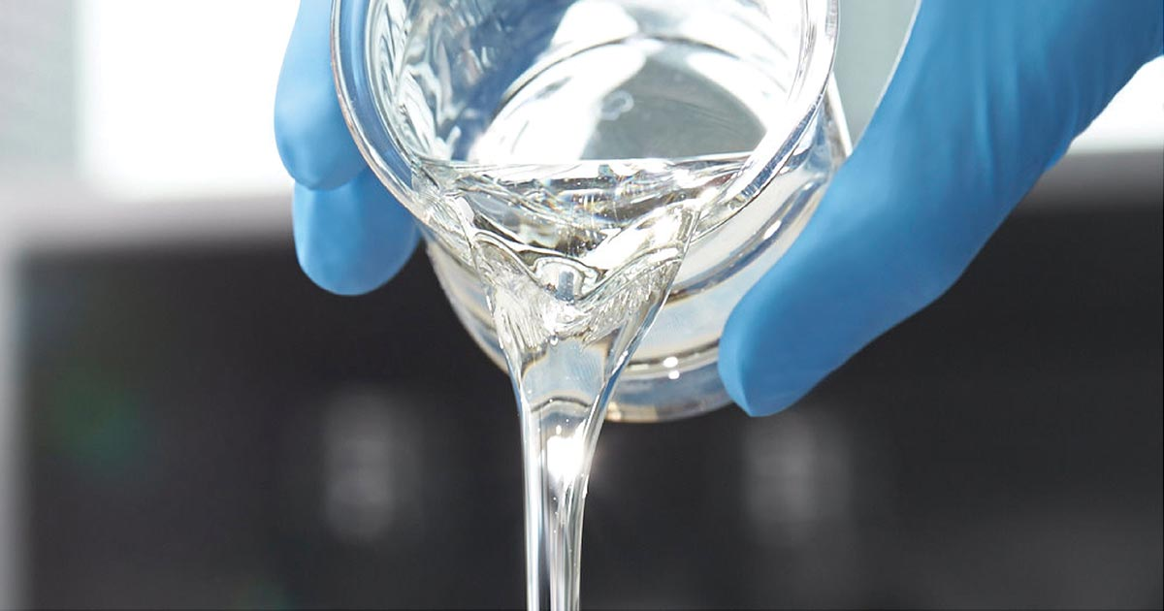
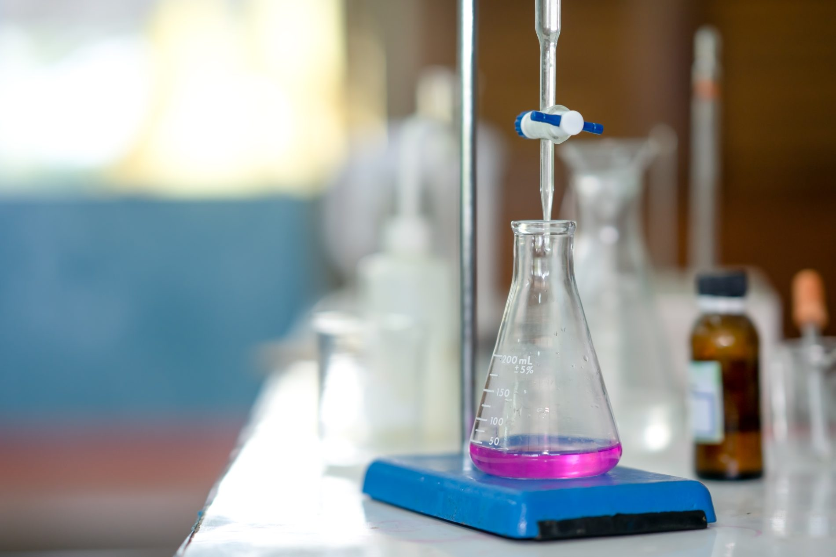
Materials and Supplies
White oil
Glacial acetic acid
Water
Laser tachometer
Buret
Pipette
Erlenmeyer flask
Phenolphthalein indicator
Parafilm
Stir Bar
NaOH

Slide 8
Experimental Procedure
Perform a titration of a sample from the tank mixture to verify the exact wt% of acetic acid in the tank
If the tank isn’t at 1 wt% acetic acid, prepare a solution to ensure the tank is at 1 wt% acetic acid
Mix the acetic acid into the tank by operation of the centrifugal pump in a closed loop
Adjust water flow rate via rotameter to 0.67 GPM and oil flow rate to 0.34 GPM
Turn on the agitators and, using the tachometer, select and calibrate the agitators
Once calibrated, turn the pump back on, close the return valve, and open the valve to the rotameter.
Allow the system to run till extraction occurs and an oil layer forms in each tank, residence time.
Once extraction occurs, note the residence time it took and draw oil and water phase samples from each tank
Titrate each sample against a 0.05 N NaOH and an indicator to determine acetic acid composition

Slide 9
Results/Discussion

Slide 11
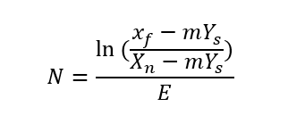
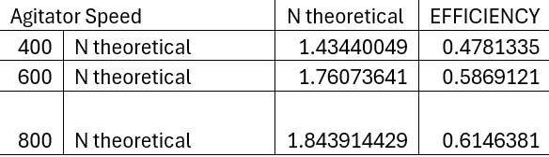
Kremser equation
N = Theoretical number of stages
Xf = Feed concentration
Xn = Exit concentration
Ys = Gas – phase Concentration
M = slope

Slide 12
Conclusion
Raffinate acetic acid concentration decreased across stages, showing effects of countercurrent extraction
Agitator speeds directly affect extraction efficiency; 400 RPM to 800 RPM showed much better performance
A Kremser analysis showed increased efficiency from higher RPM ~0.48 to ~0.61
Higher RPM allows the system to be well mixed, effectively increasing mass transfer and mass transfer area
Found a potential kinetic limitation through mass transfer resistance

